Slide 1
CRYPTOGRAPHY
Lecture 4
Instructor:
dr. zainab abaid

Slide 2
Part 1
introduction

Slide 3
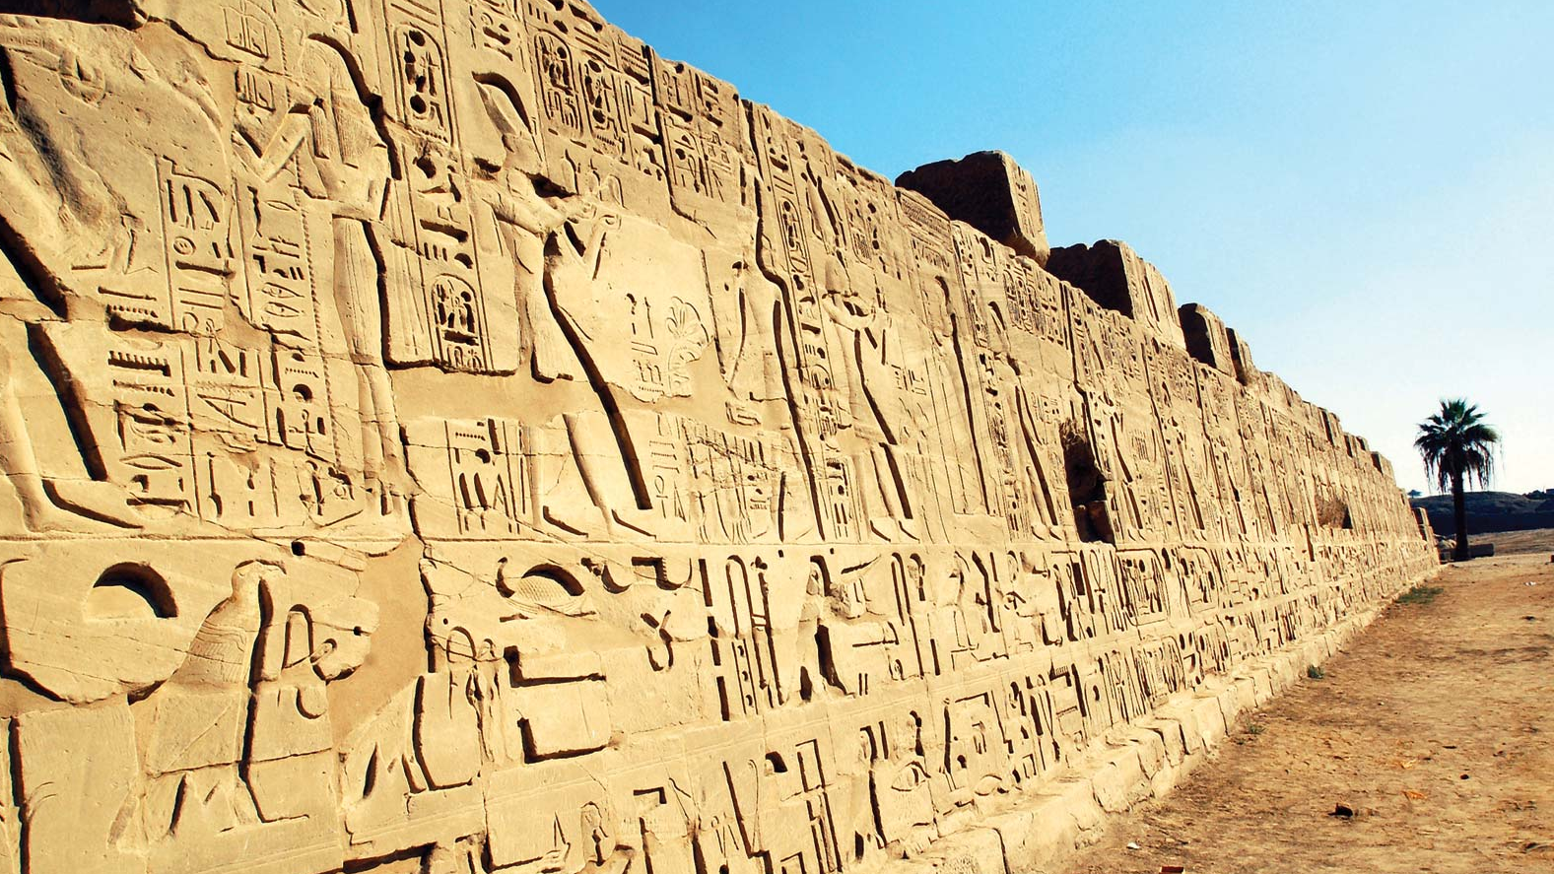
Secret Writing: Hieroglyphics

Slide 4
Secret Writing
Cryptography: kryptos graphein
Scrambled / Hidden
Steganography: steganos graphein
Covered

Slide 5
CRYPTOGRAPHY
SUBSTITUTION
01
Monoalphabetic
Polyalphabetic
TRANSPOSITION
02
Code king → cat
03
Cipher
king → qtui
04

Slide 6
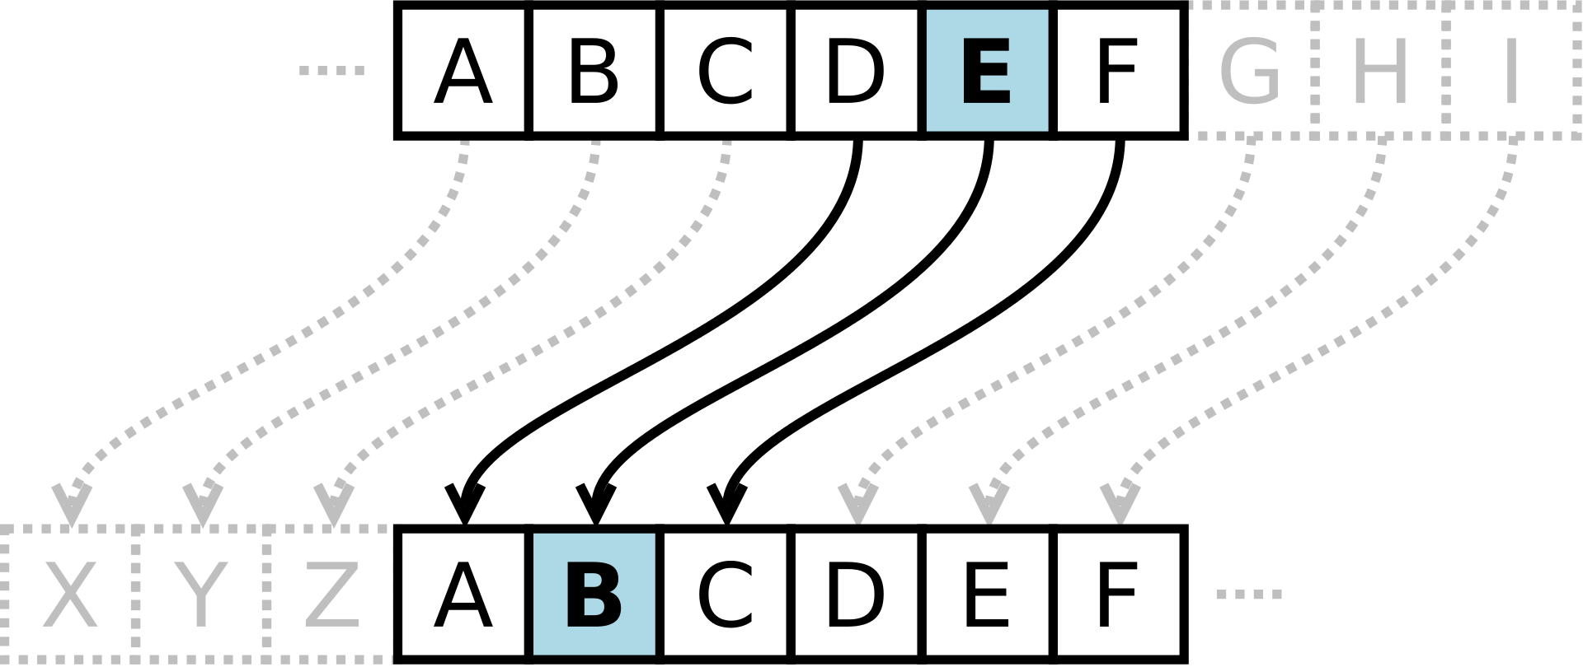
Monoalphabetic: Caesar Cipher - I

Slide 7
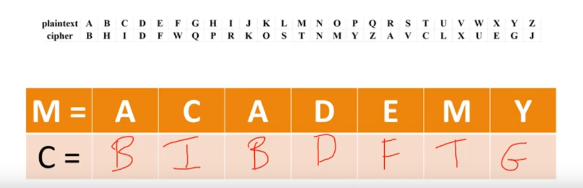
Monoalphabetic

Slide 8
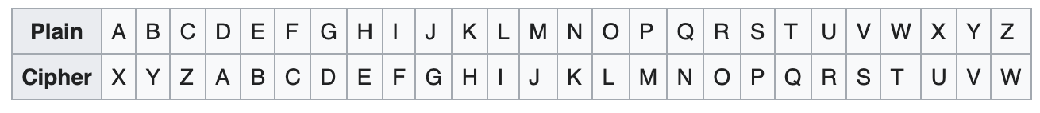
Activity
Encode INFORMATION with a right shift of 3
Notes:
LQIRUPDWLRQ

Slide 9
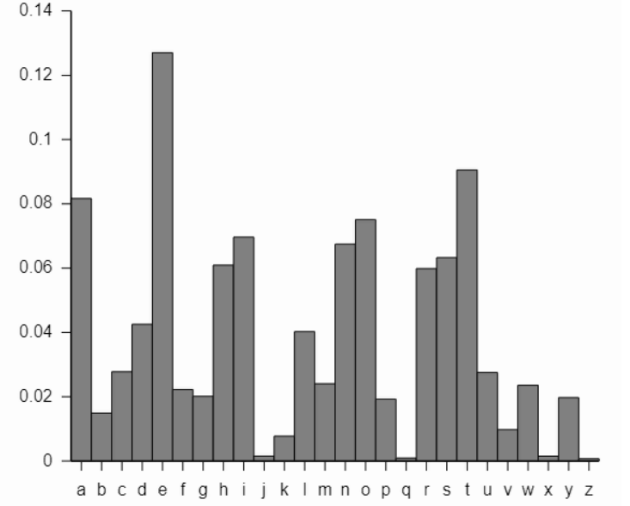
Cryptanalysis

Slide 10
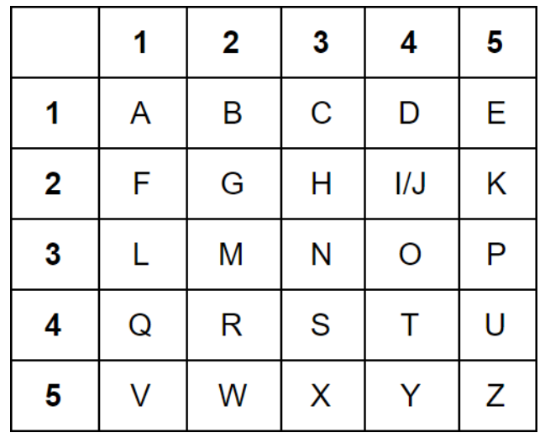
Monoalphabetic: Polybius
44 23 15 13 11 44 43 11 44 34 33 44 23 15 32 11 44
Notes:
THE CAT SAT ON THE MAT

Slide 11
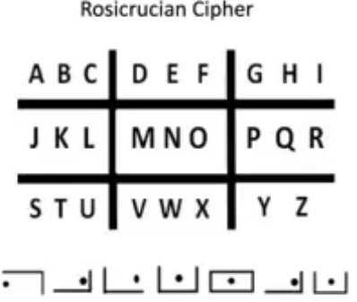
Rosicrucian Cipher
Notes:
SCIENCE

Slide 12
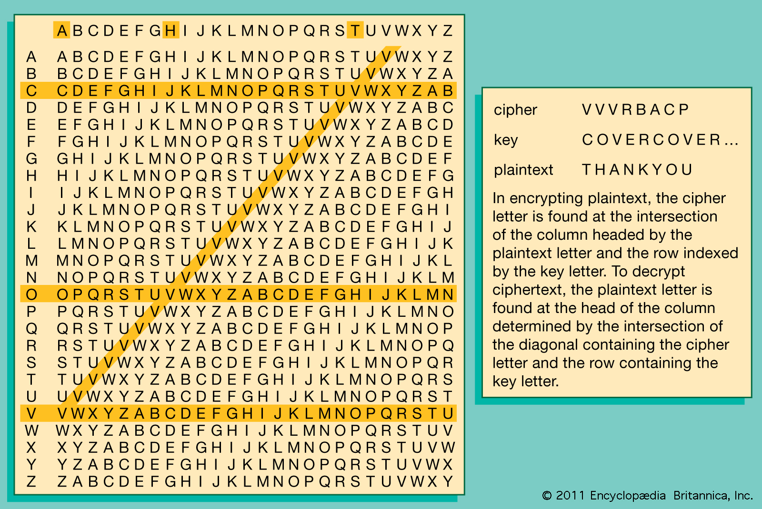
Polyalphabetic:

Slide 13
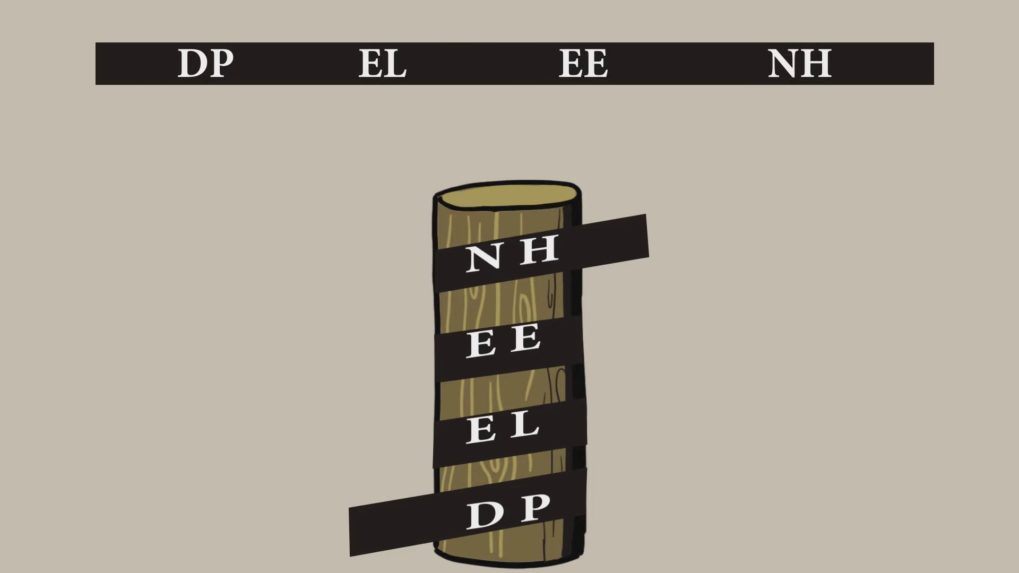
Transposition: Scytale / Staff Cipher

Slide 14
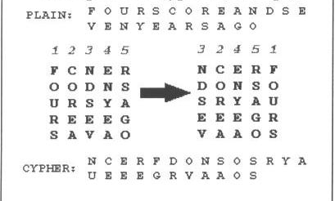
Transposition

Slide 15

Electromechanical - Enigma

Slide 16
Steganography

Slide 17
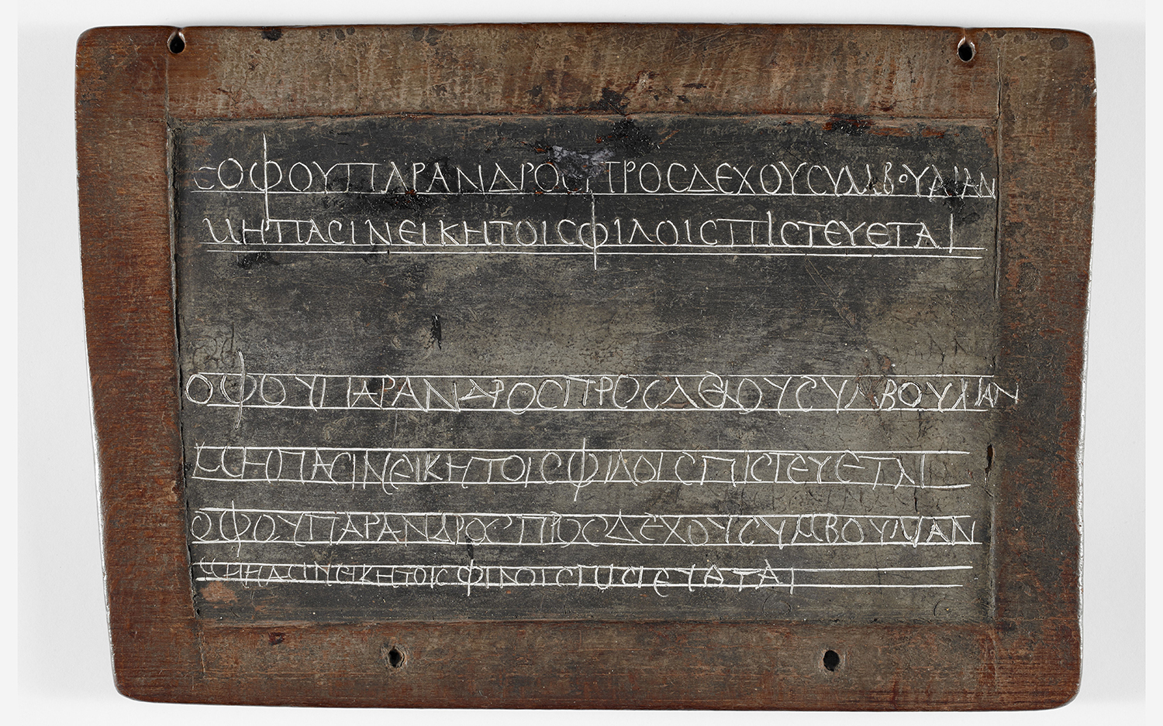
Wax Tablet

Slide 18
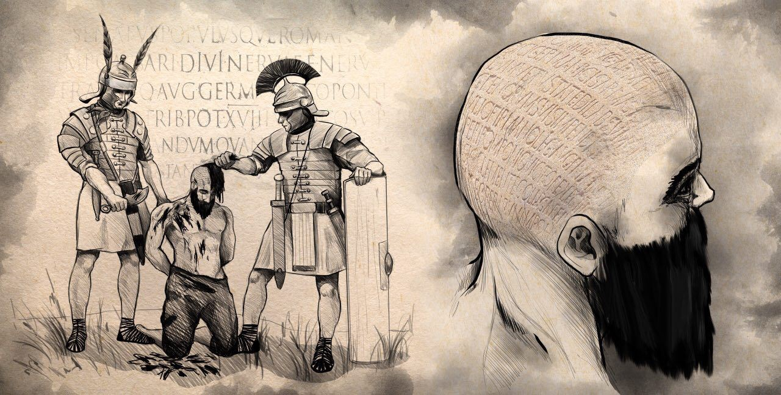
Messenger

Slide 19
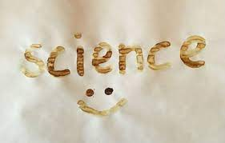
Invisible Ink

Slide 20
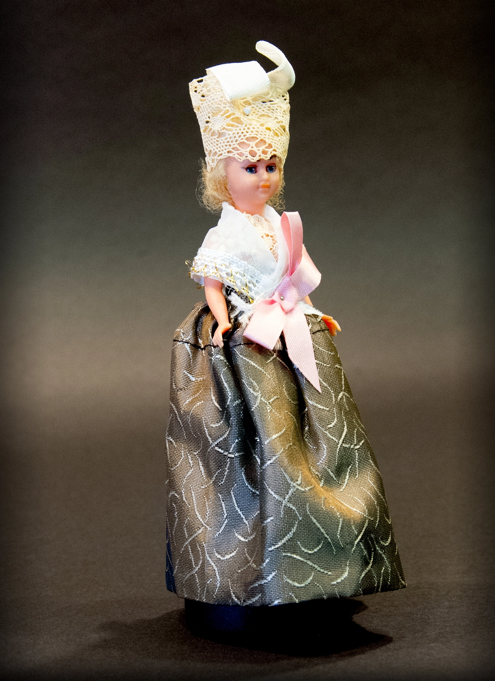
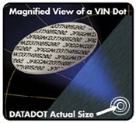
Microdots

Slide 21
Hiding message within text
An actual message from a German spy
read second letter in each word
“Apparently, neutral’s protest is thoroughly discounted and ignored. Isman hard hit. Blockade issue affect pretext for embargo on by products, ejecting suets and vegetable oils.”
“Pershing Sails from NY June 1”

Slide 22
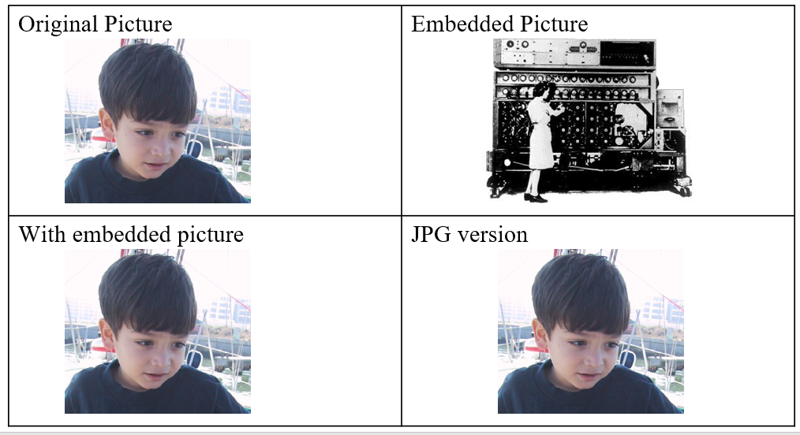

Modern Steganography (image, audio, video, html, exif)

Slide 23
Steganography vs Cryptography
Steganography is arguably weaker than cryptography because the information is revealed once the message is intercepted
On the other hand, an encrypted message that is not hidden may attract attention, and in some cases may itself incriminate the messenger
In any event, steganography can be used in conjunction with cryptography

Slide 24
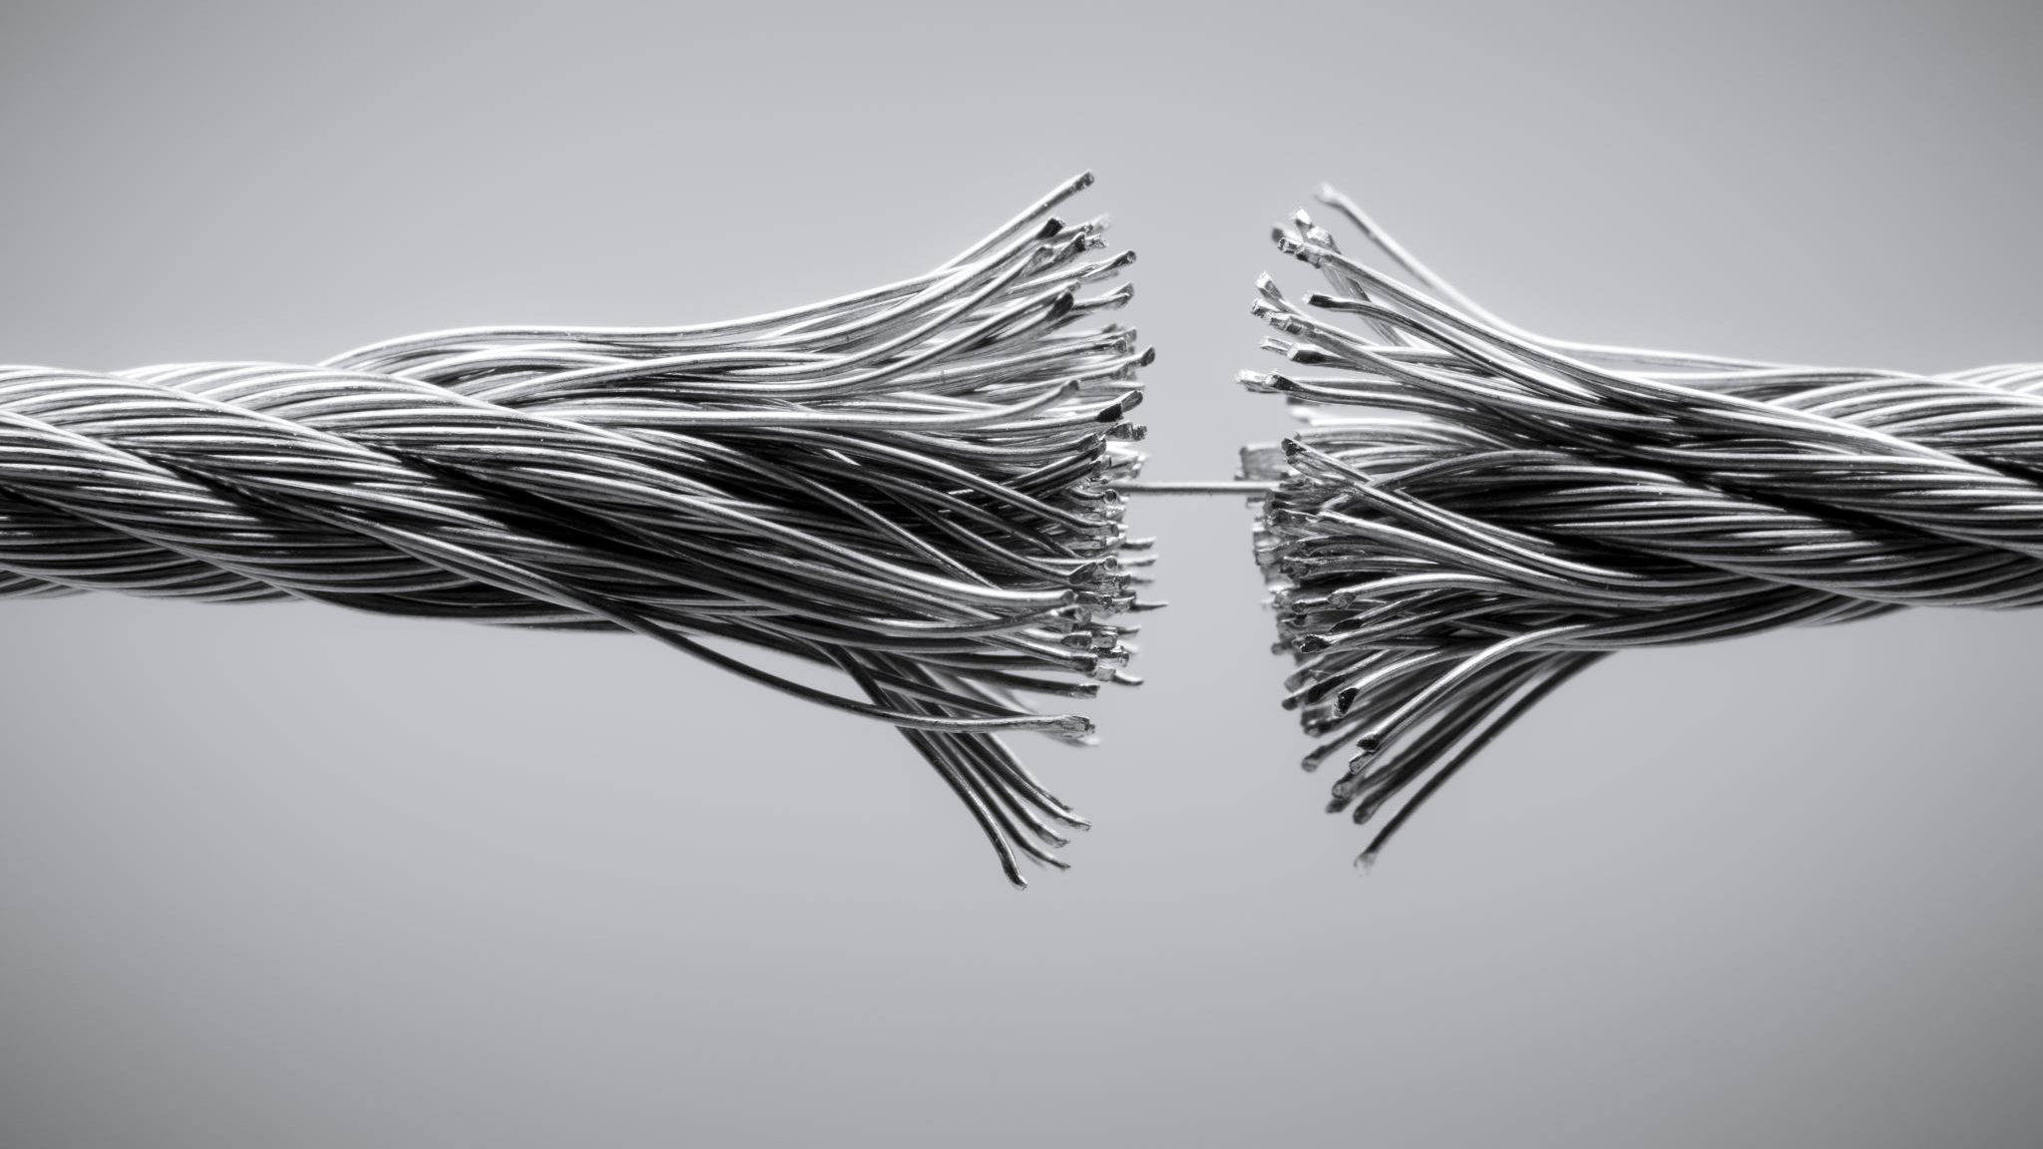
Computational hardness

Slide 25
Computational Hardness
Let’s imagine that you have encrypted an important file a year ago and then forgot the key.
You just remember that you probably used 6 letters from english alphabets, may be some of them were capital ones, digits were also possible, and your security rules required at least one special symbol.
How many possible combinations are there?
25
Notes:
All the possible password symbols are 26 alphabet letters, plus 26 capital letters, plus 10 digits, plus 33 special symbols. A total of 95 “printable” symbols in total.
95⁶= 735,091,890,625

Slide 26
Computational Hardness
To Brute Force a key that provides 1024-bits of security, Combinations to try = 2¹⁰²⁴ ~ 2¹⁰⁰⁰
Suppose
A computer runs 10²⁰ instructions per second
There are 10²⁰ computers in this world
Now you can process 10⁴⁰ instructions/ second
In one year you can process 10⁴⁰ * 60 * 60 * 24 * 365 instructions
Once again over estimate 10⁴⁰ * 10²*10² * 10²* 10³ i.e. 10⁵⁰ approx.
10⁵⁰ is approximately 2²⁰⁰
So you need 2¹⁰⁰⁰/ 2²⁰⁰ = 2⁸⁰⁰ years.
Notes:
It is theoretically possible to break such a system but it is infeasible to do so by any practical means
Computationally hard problems or intractable problems, take an unreasonable amount of time to solve, even if given all available resources
Exa scale 10^18 not yet manufactured,
Currently Peta scale 10^15 Time/ Space Complexity
Ghz -10 power 9
Even if ridiculous amount of weaknesses found = 2^{10 years} = 1024 years
NSA declassifies after 25 years

Slide 27
RSA (Rivest–Shamir–Adleman)
Factoring product of 2 large primes is a hard problem.
21
77
143
323
1073
The largest known prime number (as of September 2021) is 2^{82,589,933} − 1, a number which has 24,862,048 digits when written in base 10.
Notes:
Computational hardness assumptions make such algorithms hard to break by an adversary
7,3
11,13
19,17
29, 37
The point is, it is easy to multiply two primes, but once you have their product, its really hard to work backwards and figure out the prime factors, especially for a large number.
https://www.youtube.com/watch?v=56fa8Jz-FQQ

Slide 28
Diffie Hellman Key Exchange Protocol
Finding discrete log is a hard problem
Log_{g} x = s mod p , x= g^{s} mod p
Log₂ 9= s mod 11 9= 2^{s} mod 11
Notes:
The attacker’s job is to guess what is the s that will yield a known x, given a known g and p. There is no way to do this except enumerate all possibilities from 1 to p – 1. For a large p this is really hard to do as there are too many possibilities.

Slide 29
Diffie Hellman Key Exchange Protocol
2⁰ mod 11 =1 mod 11=1 2¹⁰
2¹ mod 11 =2 mod 11=2 2¹¹
2² mod 11 =4 mod 11=4 2¹²
2³ mod 11 =8 mod 11=8 2¹³
2⁴ mod 11 =16 mod 11=5 2¹⁴
2⁵ mod 11 =32 mod 11=10 2¹⁵
2⁶ mod 11 =64 mod 11=9 2¹⁶
2⁷ mod 11 =128 mod 11=7 2¹⁷
2⁸ mod 11 =256 mod 11=3 2¹⁸
2⁹ mod 11 =512 mod 11=6 2¹⁹
Notes:
With a prime, the secret s will actually never occur before you brute force your way up to p.
So for a large p this will take a really long time to do.

Slide 30
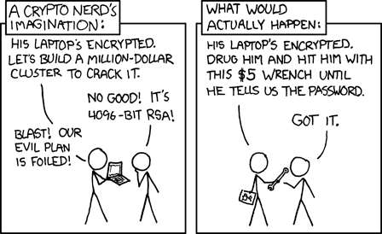

Slide 31
Side Channel Attacks
Power Consumption
Electromagnetic Radiation
Timing Analysis
Acoustic Information
Optical Information
Notes:
To overcome computational hardness of brute forcing, alternative attacks exist. Looking at side channel information, like screen brightness or sound or battery life to glean the key for example, to guess which bits were zero and one in the key.

Slide 32
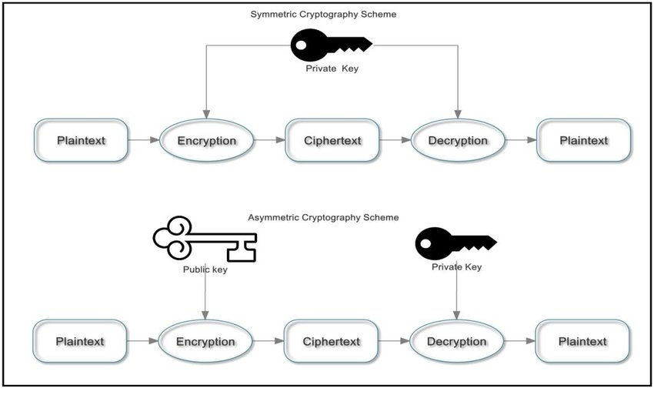
A Modern Cryptosystem

Slide 33
Symmetric vs Asymmetric Cryptography
Symmetric
Transposition and Substitution
Asymmetric
Mathematical Foundations
Key Distribution
Key management
Computational requirements

